Slide 1

Using
Data
from
an
API
Daniel Villamizar
Senior Cloud Solutions
Architect
- MVP
@danielvillamizara – https://www.linkedin.com/in/danielvillamizara/

Slide 2


Module
overview
Working with an API
Accessing API data using HttpClient
Managing the application state
Storing data locally

Slide 3
Working
with
an
API

Slide 4
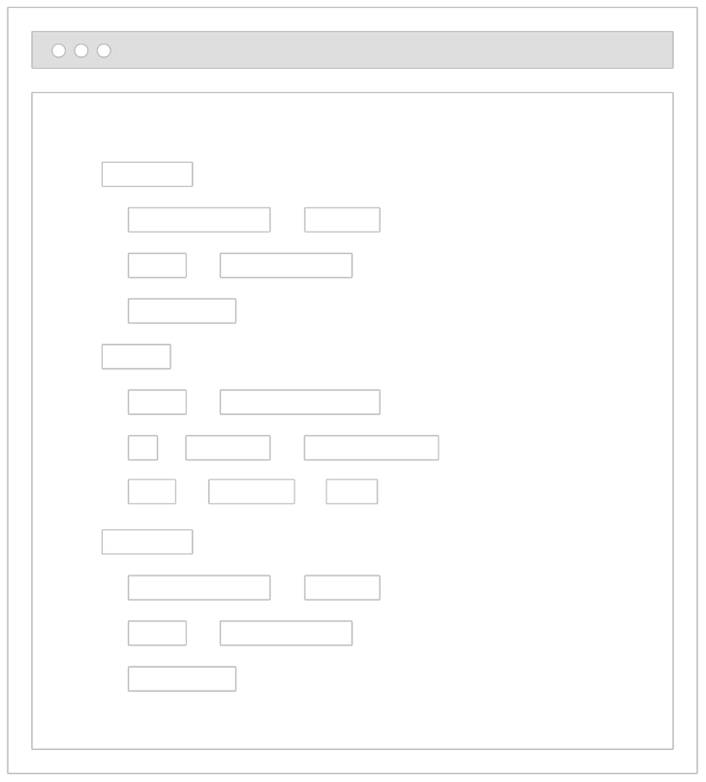
Hard
coded
data
Almost every app will use “real” data

Slide 5
Working
with
Data
Entity Framework
Core
API
Local Storage

Slide 6



Creating
an
API
Uses “just” the
data
JSON or XML
Open for many
types
of clients

Slide 7




Creating
a
RESTful
API
HTTP request
GET, POST, PUT…
Resources with
URLs
Responses in
JSON
Status codes
200, 404…

Slide 8

Accessing
a
REST
API
API
GET /api/employee
200
+ json response

Slide 9
HTTP
Verbs
GET
POST
PUT
DELETE

Slide 10
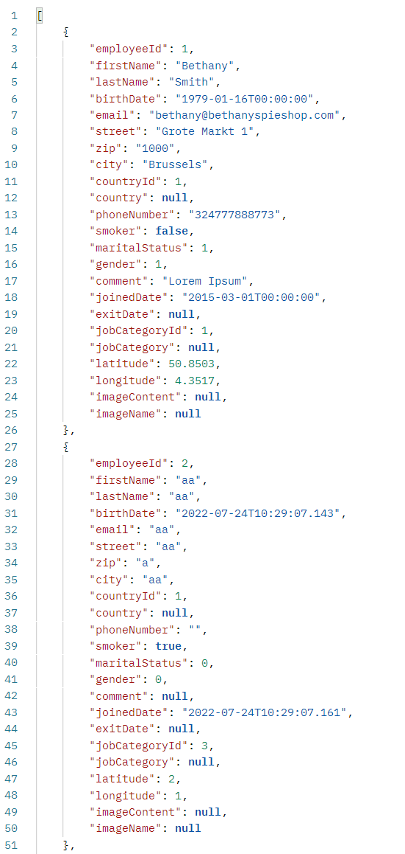
JSON
Response

Slide 11


Demo
Exploring the API
- ASP.NET Core REST API

Slide 12
Sidestep:
ASP.NET
Core
Hosted
ASP.NET Core API
API Controllers
Blazor app
ASP.NET Core project exposes the API project
and hosts the Blazor app too.

Slide 13
Demo
Moving Blazor to ASP.NET Core Hosted

Slide 14
Accessing
API
Data
Using
HttpClient

Slide 15
Interacting
with
the
REST
API
HttpClient
IHttpClientFactory

Slide 16
Sidestep:
Dependency
Injection
(DI)
MyClass
DI Container
LoggerService
ILoggerService

Slide 17

builder.Services.AddScoped(sp
=>
new
{
HttpClient
BaseAddress
=
new
Uri("http://<your-api-endpoint>")
}
);
Registering the HttpClient

Slide 18
[Inject]
public
HttpClient
HttpClient
{
get;
set;
}
Accessing the HttpClient in a Component

Slide 19
protected
{
override
async
Task
OnInitializedAsync()
Employees
= await
HttpClient.GetFromJsonAsync<Employee[]>("api/employee");
}
Working with the JSON Helper Methods

Slide 20
Available
Methods
GetFromJsonAsync()
PostAsJsonAsync()
PutAsJsonAsync()
DeleteAsync()

Slide 21

IHttpClientFactory
Used to configure and create HttpClient instances in a central location
Support for named and typed HttpClient
Requires Microsoft.Extensions.Http
package

Slide 22
builder.Services.AddHttpClient
<IEmployeeDataService,
EmployeeDataService>
(client
=> client.BaseAddress
=
new
Uri("https://localhost:44340/"));
Registering in the Program
Typed client is used here

Slide 23
Creating
a
Service
Class
public
{
class EmployeeDataService :
IEmployeeDataService
private
readonly
HttpClient
_httpClient;
public
{
EmployeeDataService(HttpClient
httpClient)
_httpClient
=
httpClient;
}
}

Slide 24
Demo
Registering the HttpClient
Creating a data service
Updating the pages to use data from the
API

Slide 25
Managing
the
Application
State

Slide 26

Application state
-
Blazor WASM is an application that’s running
in the memory of the browser
By default, each component is an island
that’s recreated every time
-

Slide 27
Application
State
Blazor app (in memory of browser)
Component 1 Component 2
“State”

Slide 28
public
{
class
ApplicationState
public int NumberOfMessages
{
get;
set; }
=
0;
}
Creating an Application State Class

Slide 29
builder.Services.AddScoped<ApplicationState>();
Adding an Instance to the DI Container

Slide 30
[Inject]
public
ApplicationState?
ApplicationState
{
get;
set;
}
int
a
=
ApplicationState.NumberOfMessages;
Accessing the Application State from Components

Slide 31

Application
State
This type of state is in-memory and will
be removed when the application restarts!

Slide 32
Demo
Adding application state

Slide 33
Storing
Data
Locally

Slide 34
Unneeded
API
Calls
Blazor app
EmployeeOverview
EmployeeDetail/3
EmployeeOverview
API

Slide 35

Adding
Local
Storage
Blazor app
EmployeeOverview
EmployeeDetail/3
EmployeeOverview
API

Slide 36


Storing
Data
Locally
Made possible through the browser,
accessible
using
JavaScript
SessionStorage or LocalStorage
Possible to use from Blazor WASM too

Slide 37
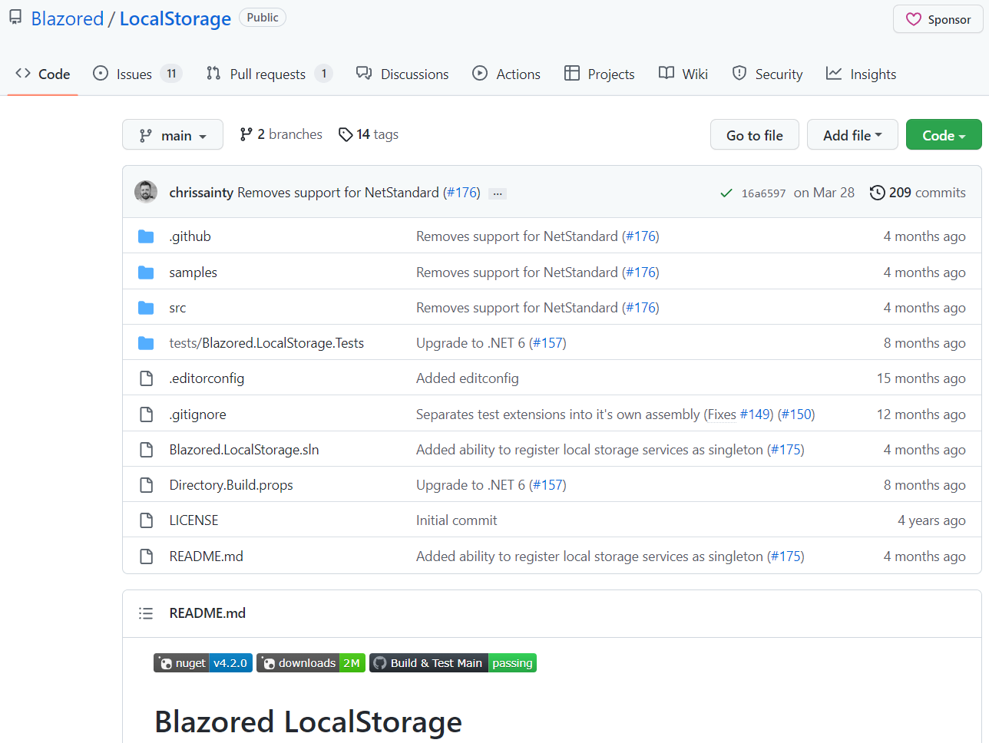
Using
Blazored
LocalStorage

Slide 38
@inject
Blazored.LocalStorage.ILocalStorageService
localStorage
var
firstName
=
await
localStorage.GetItemAsync<string>("EmployeeFirstName");
Using ILocalStorageService

Slide 39
Available
APIs
SetItem() SetItemAsync()
GetItem() GetItemAsync()
ContainKey() ContainKeyAsync()
RemoveItem() RemoveItemAsync()

Slide 40
Demo
Adding the Blazored.LocalStorage package
Extending the service with local storage support

Slide 41
Summary
APIs offer us a way to access remote data
Use HttpClient and IHttpClientFactory to access remote API
Storing data locally will reduce load on API

Slide 42

Up
next:
Creating
a
form

